Slide 1


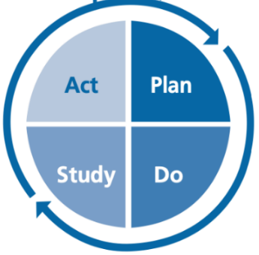

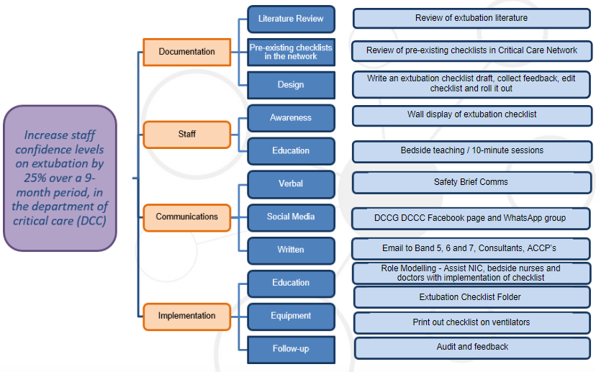


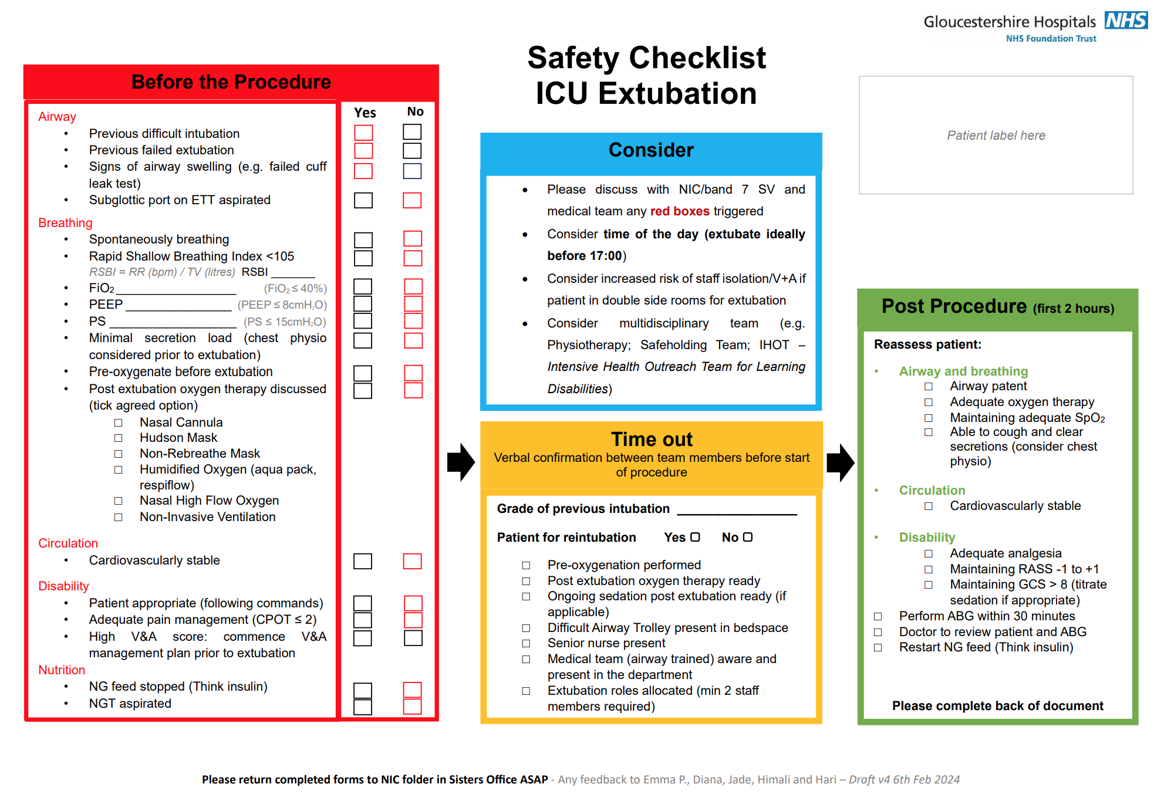
Gloucestershire Safety and Quality Improvement Academy 2024
Promoting a safe extubation in critical care
Increasing staff confidence levels on extubation
Emma Price, Diana Matos, Jade Sharpe, Himali Vitharana and Haripriya Rayasam
Background
Patients within the critical care setting, particularly those intubated, have an increased risk of airway and respiratory complications due to prolonged time on sedatives and paralysing agents. These complications are three times more common during extubation than intubation, where the use of checklists and clear communication have been suggested as strategies to minimise these risks (Foulds, L.., et. al, 2018).
Our baseline data has shown that 15% of extubations led to reintubation within 72 hours, and 20% of staff felt there was no clear plan for extubation. Also, 63% had experienced an unplanned or poorly planned extubation. Failed extubations that are higher than 5-10% are likely to lead to unnecessary prolonged intubation of critically unwell patients (Nickson, C., 2024).
The high acuity of our critical care unit, junior and rotational workforce (where only 39% of DCC nurses had their critical care course) and lack of standardised extubation procedure at the time, have contributed to the reduced confidence levels found in the initial staff survey (where only 27% of nurses felt completely confident with extubation). Furthermore, 84% of our staff expressed they would benefit from an extubation checklist.
PDSA Cycles
PDSA Cycle 1
PDSA Cycle 2
PDSA Cycle 3
Design an extubation checklist for DCC, aligning with local safety standards for invasive procedures’ format.
Collect feedback and amend it accordingly to go live in Jan 24
Update checklist following feedback from staff (add date, time and staff involved to ensure accuracy and assist with compliance)
Continue monthly audits of the checklist compliance
Staff confidence levels re-assessed with ‘mid-point’ questionnaire (May 24)
Visual reminder added to ventilators to maintain checklist compliance >70%
Staff updated via emails with monthly compliance reports; encouraged bedside/tea trolley teaching
Staff confidence levels re-assessed with final questionnaire (Sep 24)
Aim
In response to that, our aim was to increase staff confidence levels on extubation in DCC by 25% over a 9-month period (Jan 24 – Sep 24). This included the distribution of a staff questionnaire (before, during and post intervention), the design and implementation of an extubation checklist, collection of feedback, education on the new tool and monthly compliance reports to achieve a minimal of 70% staff compliance throughout this project.
Outcome Measure
Distribute a questionnaire to assess staff confidence levels on the extubation process (Dec 23, May 24 and Sep 24)
Process Measures
Design an extubation checklist to comply with safety guidelines for invasive procedures
Educate 60% of staff through tea-trolley sessions, bedside teaching and attendance to departmental meetings
Audit the extubation checklist compliance (monthly) and maintain a minimum of 70% compliance on its full completion
Balancing Measures
Measure the number of failed extubations
Measure the number of intubated days
Measure the length of stay (in days) in DCC
Driver Diagram
Data and Results
Total of 40% increase in staff confidence levels on extubation in critical care
More than 70% checklist compliance achieved throughout our project (71%-100%)
There was a 15% reduction in the number of failed extubations
There was no change to the average of days (three) a patient remained intubated for
Slight reduction in the length of DCC stay from 7 to 5 days since the extubation checklist was implemented
Variable critical care acuity levels and patients' multiple comorbidities might have affected our percentage of failed extubations, length of intubation and length of DCC stay.
All of which were taken into consideration when analysing and interpreting our results.
Fig. 1 – Extubation Checklist designed and implemented in DCC
Next Steps
Run a snap-shot audit at 12 months (Jan 2025) to assess staff confidence levels, checklist compliance, percentage of failed extubations, length of intubation and length of DCC stay
Have the extubation checklist agreed and embedded in the Trust's documentation and facilitate the journey to a digital future by having it added to Sunrise: EPR
Facilitate further quality improvement projects within the unit: CCPOT (pain assessment) and nursing lead respiratory weaning for ventilated patients
#TheGSQIAWay

